Slide 1


Public Services Ombudsman for Wales Customer Satisfaction Survey 2020
Survey Findings
Prepared for:
Public Services Ombudsman for Wales
Prepared by:
Beaufort Research

Slide 2




Contact Details
Agency contact: Fiona McAllister / Owen Knight
Project: B02008
Date: March 2020
Beaufort Research
2 Museum Place
Cardiff
CF10 3BG
Tel: 029 2037 8565
E-mail: enquiries@beaufortresearch.co.uk
www.beaufortresearch.co.uk
Terms of Contract
Unless otherwise agreed, the findings of this study remain the copyright of Beaufort Research Ltd and may not be quoted, published or reproduced without the company’s advance approval.
Approval to quote or publish will only be withheld on the grounds of inaccuracy or misrepresentation.
Any approved publication must detail Beaufort Research Ltd as provider, sample size and field dates.
© Beaufort Research Ltd 2020
This project was carried out in compliance with ISO20252

Slide 3
Background & Methodology
The Public Services Ombudsman for Wales (PSOW) commissioned Beaufort Research to undertake a survey of service users to understand satisfaction with the service received.
The research universe consisted of all service users whose cases were closed between 1 April and 31 December 2019.
A total of 204 interviews were conducted by telephone utilising CATI (Computer Aided Telephone Interviewing) from 2nd to 12th March 2020.
All participants offered the opportunity to be interviewed in English or Welsh
Quotas set on case type, stage and outcome to boost number of interviews completed with CODE, Investigation and Intervention case/stage/outcome types to enable some analysis of these groups*
Data weighted to reflect the profile of casework types, stages and outcomes for the period.
 | No. of interviews | Weighted %
Type
Maladministration (MAL) | 177 | 91%
Code of Conduct (CODE) | 27 | 9%
Stage
Assessment | 153 | 87%
Investigation | 51 | 13%
Outcome
No intervention | 130 | 79%
Intervention – fault found | 60 | 17%
Intervention – no fault found | 14 | 3%
TOTAL | 204 | 100%
*N.B. Care should be taken when interpreting data with small sample sizes.
Notes:
BASELINE

Slide 4
Initial contact

Slide 5
Sources of awareness
How did you found out about the Ombudsman? (Unprompted, %)
➔ (20% where subject = Health)
Base (all): 204

Slide 6
Sources of awareness
How did you found out about the Ombudsman? (Unprompted, %)
27% found out about PSOW via organisation / individual
Base (all): 204

Slide 7
Ease of getting in touch
When you first contacted the Ombudsman, how easy or difficult was it to get in touch? (%)
91% very / fairly easy
8% very / fairly difficult
Base (all): 204

Slide 8
Suggested improvements
Would you like to suggest any ways in which the Ombudsman’s office could improve its service? (Main mentions, %)
Base (all): 204

Slide 9
Assistance & advocacy
Did you receive any help in making the complaint from an advice or advocacy service? (%)
Did anybody at the Ombudsman’s office offer to put you in touch with someone who could provide such help? (%)
Base (all): 204
Base (those who received any help from an advice or advocacy service): 21*
*Care should be taken when interpreting data with small sample sizes.

Slide 10
Communication
Did someone ask you how you would prefer to communicate with them – i.e. by post, telephone, email? (%)
Did the Ombudsman’s staff use your preferred method to communicate with you about your case? (%)
Were you asked if you had any additional requirements for communicating with the Ombudsman, e.g. large print, translation, files in digital format, meetings over Skype? (%)
Base (all): 204

Slide 11
Communication
Did someone ask you how you would prefer to communicate with them – i.e. by post, telephone, email? (%)
Did the Ombudsman’s staff use your preferred method to communicate with you about your case? (%)
Were you asked if you had any additional requirements for communicating with the Ombudsman, e.g. large print, translation, files in digital format, meetings over Skype? (%)
Stage: Assessment = 56%
Investigation = 70%
Stage: Assessment = 69%
Investigation = 77%
Stage: Assessment = 36%
Investigation = 43%
Base (all): 204

Slide 12
Satisfaction – PSOW role, process and complaint consideration
Extent agree / disagree… (%)
I was given clear information about the Ombudsman’s process for handling complaints
I was given clear information about the Ombudsman’s role and what the office can and cannot do
My complaint was considered in a timely manner
My complaint was considered impartially
My complaint was considered thoroughly taking account of all relevant evidence
Base (all): 204

Slide 13
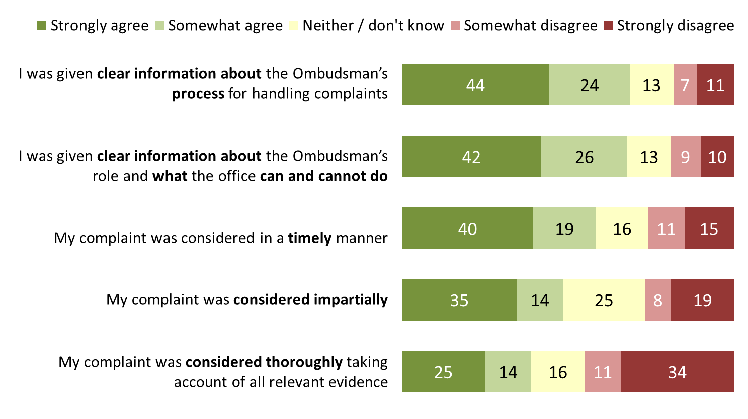
Satisfaction – PSOW role, process and complaint consideration
Extent agree / disagree… (%)
Did the staff at the Ombudsman explain the reason for the delay?
22% = Yes
74% = No
4% = Don’t remember
Base (all): 204

Slide 14
Satisfaction - Staff
Extent agree / disagree… (%)
The staff I dealt with have treated me with courtesy and respect
The staff handled my complaint according to the process explained to me
Staff kept me updated throughout the process in the way we agreed
Staff have been easy to get hold of
The staff at the Ombudsman had a good understanding of my complaint
Base (all): 204

Slide 15
Customer service – Overall satisfaction
Overall, how satisfied or dissatisfied are you with the level of customer service that you have received from the Ombudsman? (%)
Satisfaction - Outcome
Stage
Case Type
Outcome Group
Subject
Base*:
204
153
51
27
177
16
14
130
62
116
76
99
*Care should be taken when interpreting data with particularly small base sizes
Notes:
LN very likely to attend
All = 17%
55+ = 21%

Slide 16
Outcome – Overall satisfaction
Overall, how satisfied or dissatisfied are you with the outcome of your complaint? (%)
Satisfaction - Customer Service
Stage
Case Type
Outcome Group
Subject
Base*:
204
153
51
27
177
16
14
130
115
60
76
99
*Care should be taken when interpreting data with particularly small base sizes
Notes:
LN very likely to attend
All = 17%
55+ = 21%

Slide 17
Outcome
Did you feel you would be able to ask for the decision to be reviewed? (%)
Base (those who were dissatisfied with the outcome of their complaint): 116

Slide 18
Outcome – Communication of decision
Did the staff at the Ombudsman explain clearly the reason for the decision? (%)
Outcome Group
Base: all (204), intervention – fault found (60), intervention – no fault found (14*), no intervention (130)
*Care should be taken when interpreting data with particularly small base sizes
Notes:
LN very likely to attend
All = 17%
55+ = 21%

Slide 19
Suggested improvements
Would you like to suggest any ways in which the Ombudsman’s office could improve its service? (Main mentions, %)
28% mention issues with contact / communication / speed
Base (all): 204

Slide 20
Public Services Ombudsman for Wales Customer Satisfaction Survey 2020
Survey Findings
Prepared for:
Public Services Ombudsman for Wales
Prepared by:
Beaufort Research

